Slide 1
Application Insights

Slide 2
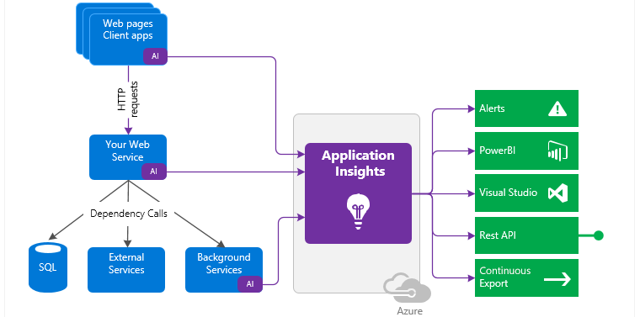
Application Insights

Slide 3
What is Application Insights?
Use it to monitor live applications
It will automatically detect performance anomalies
Includes powerful analytics tools to
Help diagnose issues and
Understand what users actually do with app
Designed to help continuously improve performance and usability

Slide 4
How is works?
Install SDK in application or
Enable Application Insights when supported
It monitors app and directs the telemetry data to an Azure Application Insights Resource
Can instrument not only the web service application, but also any background components, and the JavaScript
The application and its components can run anywhere - it doesn't have to be hosted in Azure

Slide 5
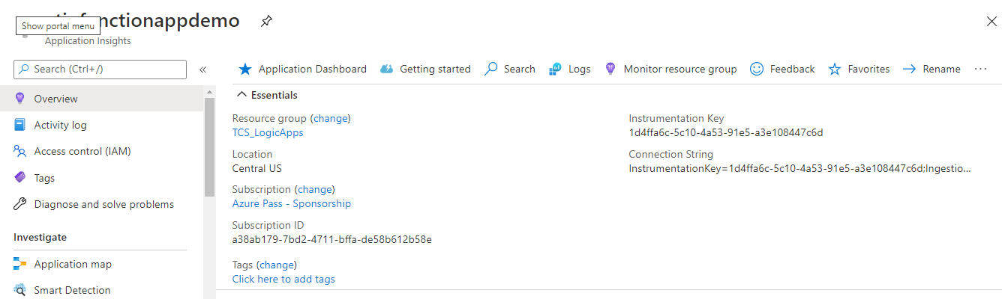
Application Insights Resource

Slide 6
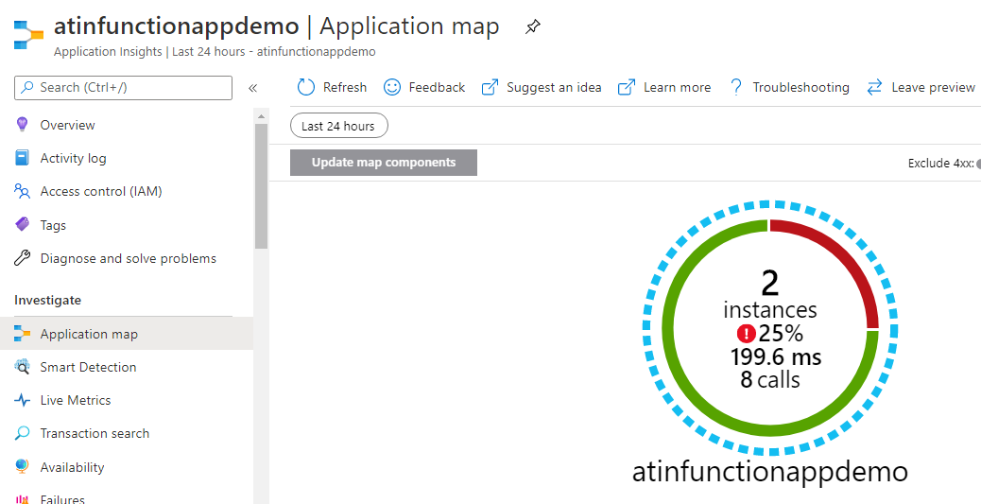
Application Insights: Application Map

Slide 7
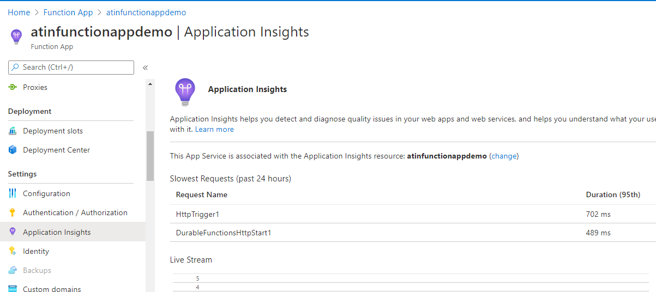
Connect Function App with App Insights

Slide 8
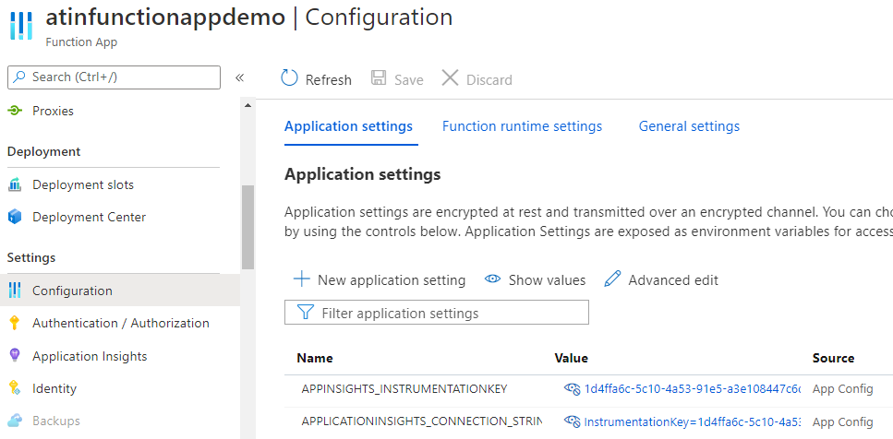
Connect Function App with App Insights

Slide 9
Reference
https://docs.microsoft.com/en-us/azure/azure-monitor/app/app-insights-overview

Slide 10


